Slide 1
Incident Classification

Slide 2
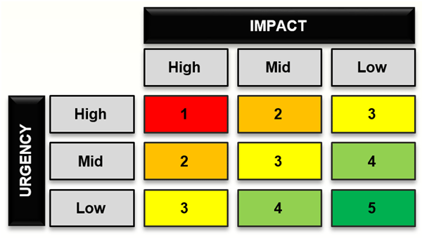
Challenge
Manually labelling incidents is a tedious, costly and time-exhaustive process
IT team has limited capacity
Generated incidents contain information about location, time of creation, user symptom …
Analyze the data and obtain relevant features for prediction
Apply ML to remove the need of manual identification of incidents
Significantly reduce IT team overhead on labelling

Slide 3
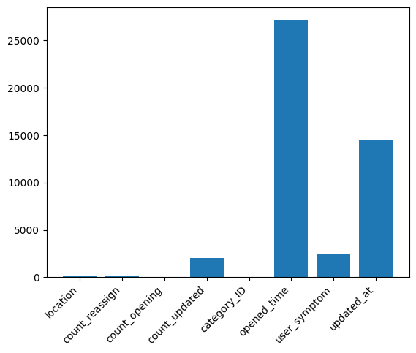
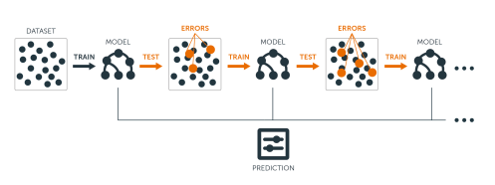
Solution
Process dataset and extract relevant attributes(features) for prediction
Learn model (GradientBoostedTrees) on labeled data to predict future incoming incidents
Classify incoming incidents, prioritizing those with high impact

Slide 4
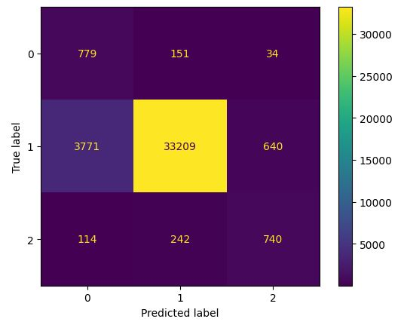
Results
Model accurately classifies incidents of high importance in over 80% of cases
The overall accuracy of the model is over 90%
It can significantly reduce IT team involvement
Over-time the model can be re-trained and the performance improved

